Slide 1
Cognos Reports – Project
Budgets
Ellen Whatley, HPS
Rebekah Bewley, Budget Office

Slide 2
Agenda
Objective
The Basics
9.2 Cognos Project Reports Introduction - Demo
Wrap Up

Slide 3
Objective
Learn how to read the Cognos Project reports

Slide 4
The Basics

Slide 5
Project Types
Sponsored
NGRCT – Grants and Contracts
Non Sponsored
NDISC - Discretionary
NFCAP - Capital
NINTP – Internal

Slide 6
Project Types - Sponsored
NGRCT – Grants & Contracts
The second character in the code indicates the funding source:
GSXXXX = State Funded
GFXXXX = Federally Funded
GPXXXX = Private Foundation Funded
Budgetary changes are handled by OGCA via a Triple A (Award Adjustment Approval Request) rather than through an ABA

Slide 7
Project Types – Non Sponsored
NDISC – Discretionary
Used to account for project balances not related to grants or construction
Funds Commonly used:
Fund 850000 F&A Recovery Fund <IDC, Overhead>
Fund 840002 Faculty Startup
Fund 840001 Faculty Discretionary
Fund 885000 Departmental Discretionary
NFCAP – Capital (Construction)
NINTP – Internal Projects (University funded grants)
Project values

Slide 8
Project Tips
Non Sponsored. NSP project codes can be used on multiple chartstrings. The combination of all the chartfields in conjunction with the project code is what makes the chartstring unique.
Sponsored Projects. Generally a grant should only be tied to a single chartstring. You will rarely see the same grant number used on different chartstrings.

Slide 9
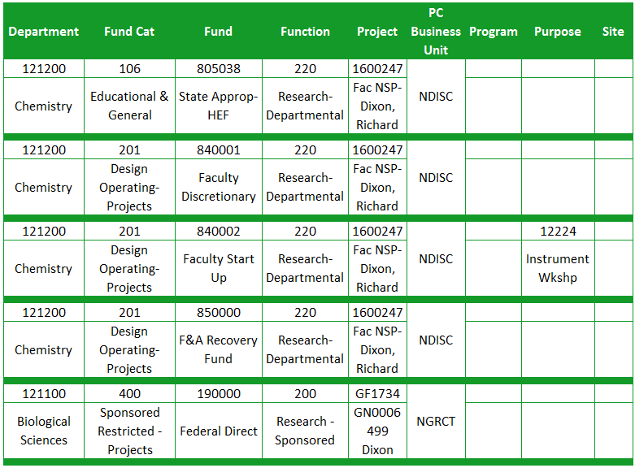

Slide 10
Project Tips
Any chartstring with a project code is considered a project.
Projects appear on the project report not on the Departmental Report. This includes faculty discretionary funds.
Projects are reported life-to-date. Use transaction detail report to view a particular year at a time.
Signature Authority (aka approval) is held at the Org-Dept level and at the Project level.

Slide 11
Reporting Demo

Slide 12
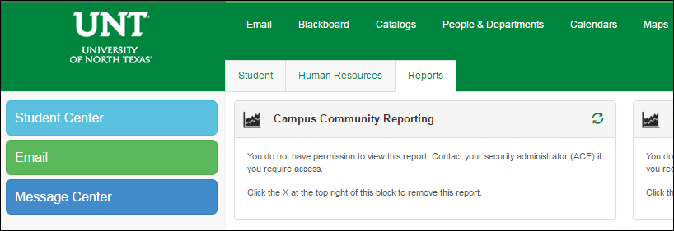
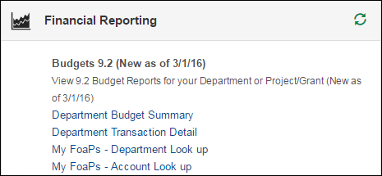
Getting Started
Log into my.unt.edu
Select the “Reports” tab
Reports are located in the “Financial Reporting” section

Slide 13
Resources

Slide 14
Budget Website
Whom to Contact
Support>Whom To Contact
List of departmental contacts by issue (IDTs, ABAs, ePros, ePars, etc.)
Announcements
Find out any new information you should be aware of that could affect your budget
Training Materials
Training > Training Materials
List of all training documents
Documents
Resources > Documents
List of Budget Management Help Documents

Slide 15
Questions?

Slide 16
Thank You.

