Slide 1
Finding a Transdisciplinary Path: Philosophizing in the Age of Ethereal Control
Alex Mosiak
Graduate Research Assistant
Keith Brown
Center Progams Manager
Kelli Barr Graduate Research Assistant
A Triptych Aimed at Engaging the Connections Between De-, Inter-, & Transdisciplinization
www.csid.unt.edu

Slide 2
Reclaiming Cynicism: Philosophy Beyond the Academy
Alex Mosiak
Department of Philosophy and Religion Studies
Center for the Study of
Interdisciplinarity
University of
North Texas
www.csid.unt.edu

Slide 3
Overview
Academic Philosophy
Historical Contingency
Current Academic “Accountability”
The Cynical Turn
Potential Modes of Philosophical Practice:
Monastic (Communal)
Stoic (Political)
‘Reclaiming Cynicism: Philosophy Beyond the Academy’
North Texas Philosophical Association
University of North Texas
April 7 – 9, 2011
Notes:
For my portion of this colloquium, I’m going to
I. Present a brief sketch of philosophy as it is academically practiced today, an anecdote illustrating the risks of academic situatedness, and the bleak situation it finds itself in today.
II. Call for what I would like to characterize as a cynical re-evaluation of current practice.
III. Suggest potential modes of philosophy that might complement academic practice, making it more resilient.

Slide 4
Academic Philosophy
Research-focused
Production and critique of philosophical knowledge in professional forums
conferences, journals, etc.
Theoretical specificity promotes clarity and critical rigor
Faust (Rembrandt)
‘Reclaiming Cynicism: Philosophy Beyond the Academy’
North Texas Philosophical Association
University of North Texas
April 7 – 9, 2011
Notes:
Teaching secondary – oriented, at the graduate level, at producing strong researchers.
Journals can focus on extremely particular sub-fields of philosophy.
Audience: other academics
Speaking solely to this audience is incentivized by hiring practices.

Slide 5
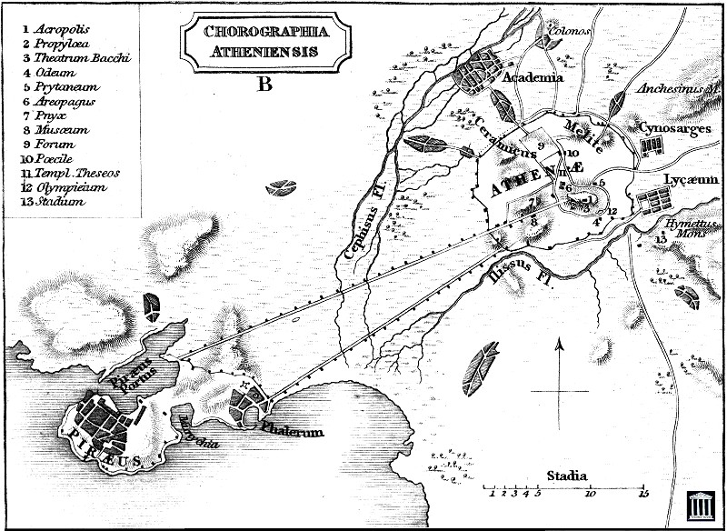
Academic Contingency
‘Reclaiming Cynicism: Philosophy Beyond the Academy’
North Texas Philosophical Association
University of North Texas
April 7 – 9, 2011
Notes:
Ancient Athens:
Academy outside walls,
When Sparta attacked Athens, it spared the Academy, out of respect for what was considered sacred ground.
In 86 B.C., the Roman general Sulla laid siege to Athens to put down it’s rebellion against Rome. He destroyed the Academy and cut down its groves of oaks and olive trees in order to build siege engines and battering rams to breach Athenian defenses.
Lesson:
Academic freedom from the acropolis –political authority
academic autonomy from the agora – the marketplace,
carries risks: existence contingent upon cultural respect and the socioeconomic conditions of the time

Slide 6
Academic “Accountability”
Neoliberal attack on public universities underway
University of Southern Mississippi – most severe cuts to College of Arts and Letters
SUNY Albany cuts 5 humanities programs
“Middlesex University cuts philosophy program” – Times Higher Education Supplement
‘Reclaiming Cynicism: Philosophy Beyond the Academy’
North Texas Philosophical Association
University of North Texas
April 7 – 9, 2011
Notes:
The socioeconomic climate of our times is grim.
Respect for academia is diminishing due to a confluence of ideological, social, political, and economic factors. This often appears as a demand for fiscal accountability,
III. Which means “produce something of value or be defunded.” This is easily and frequently reduced to economic value.
IV. Departments that can reactively adapt to this demand are doing so. Collaboration with the corporate sector is a common method, for example through technology transfer.
For philosophy, this is not feasible. A significant method of adaptation in philosophy departments, as well as the other humanities is replacement of tenured faculty with adjunct faculty, who are paid less and have fewer benefits.
V. I believe this mimics the prevailing model of late capitalism with its “just-in-time” use of individuals as interchangeable, and ultimately disposable wage-laborers.
VI. It would be ideal if academics could not only critique this situation, but resist it.

Slide 7
The Cynical Turn
Recognizes an actual situation as a compound of necessity and convention
Critiques identification of actuality with necessity
Contradicts conventional practice
Diogenes the Cynic
‘Reclaiming Cynicism: Philosophy Beyond the Academy’
North Texas Philosophical Association
University of North Texas
April 7 – 9, 2011
Notes:
A rehabilitated Cynicism, which has taken on connotations not in keeping with its philosophical heritage, could be vital to this project. The term ‘cynic’ is often applied to someone skeptical of professed altruistic motives of individuals and institutions. This limited interpretation of a cynic is of someone who recognizes a situation as a sham, but plays along with it anyway - with some bitterness.
II. The philosophical meaning is broader and deeper - what I shorthand here as the “cynical turn” is one in which an actual situation is recognized as a mixture of inflexible necessity and human convention, which is malleable. Without the false attribution of necessity blanketing a situation, actuality is no longer given ontological priority over potentiality. This clears space for original action - action not merely reactive to actual demands.
III. While the “cynical turn” is relevant to every field of human endeavor, it’s extremely reflexive and therefore relevant to philosophy itself.
We might recognize that philosophy is not necessarily limited to academic practice, and that necessity might be on the other side - that academic philosophy needs to change.. So I will suggest a couple of complementary modes – the monastic and stoic. Keep in mind that these are not necessary either. But they might improve the resilience of public philosophy.

Slide 8
New Practices: Monastic Philosophy
Renunciation of academic production
Separate teaching and research faculty
Separate incentive structures
Separate evaluative metrics
Local public engagement
‘Reclaiming Cynicism: Philosophy Beyond the Academy’
North Texas Philosophical Association
University of North Texas
April 7 – 9, 2011
Notes:
By monastic I mean to evoke a philosophical pursuit in which the community is emphasized over the individual and practice is emphasized over theory.
We’re moderns – monastic sounds medieval – it’s meant to. It’s meant to suggest the need to renounce something in order to regain something lost.
II. As Pierre Hadot argued, philosophy was once not merely theory-driven, but was practiced as a way of life. This understanding has been obscured as philosophy has become disciplinized over the last two centuries within the modern research university. For this practice it could be necessary to renounce academic production to focus on teaching. For this to be anything more than an absurd ideal a department would have to:
III. Separate the teaching faculty and research faculty. Separate incentives, separate metrics.
IV. Within the teaching faculty, incentivize local public engagement. For example, teaching philosophy in public elementary and secondary schools.
Now it could be objected that this sounds utopian,
But I would argue that the utopian belief is in the continued existence of an institution with limited to no interaction with the broader community of which it is a part.
Pragmatically, local face-to-face public engagement can be looked at as an authentic investment - encouraging children to value philosophy,
and as a response to insincere demands for “accountability,” that is, making an impact on society.

Slide 9
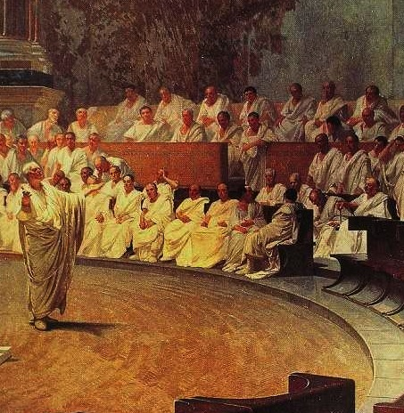
Stoic Philosophy
Political justification in public forums
Incentivize willingness to be confrontational when necessary
Non-academic media
interdisciplinary conferences, administrative meetings, op-eds, letters to the editor, blogs
Alliance building
threatened sub-disciplines (e.g. climatology)
public employees (e.g. university staff)
Cicero
‘Reclaiming Cynicism: Philosophy Beyond the Academy’
North Texas Philosophical Association
University of North Texas
April 7 – 9, 2011
Notes:
To supplement this mode I suggest a Stoic practice of philosophy:
The Stoics took their name not from their theory, but from the colonnade in the Agora where they practiced philosophy – the Stoa Pokile – an open space where they claimed, by their very presence, to be in the marketplace, yet not of the marketplace.
I. Academic philosophy seeks public investment in a political culture that is growing intolerant of providing that investment, therefore it must publically justify itself.
But while individual academics are disincentivized to attract public attention for political views, support for the public funding of philosophy is a political position – one which is increasingly coming under pressure. Philosophy as a public good which merits public funding is a philosophical argument, one which needs defense. In light of how public debates tend to get nowadays, the stoic must be willing to confront extremely hostile interlocutors.
II. Can a philosopher “do” philosophy in non-academic media? It’s time to undertake the experiment. A variety of audiences would have to be considered in each instance, arguments framed and phrased accordingly. This would have to be institutionally supported and incentivized as well – current professional metrics inadequately recognize such endeavors.
III. It would be naïve to think that most people are interested in engaging in philosophical dialogue or listening to philosophical arguments. However, groups threatened by the same political sources and neoliberal trends could be receptive audiences and possible partners in resistance, that I believe, one way or another, will become increasingly imperative.

