Slide 1
A Simplified Approach to Service Continuity Planning
Dan Wilson
Coordinator, NN/LM Emergency Preparedness & Response Plan
Associate Director for Collection Management & Access Services, Claude Moore Health Sciences Library, University of Virginia
Susan Yowell
Project Assistant, NN/LM Emergency Preparedness & Response Plan
Project Assistant, Claude Moore Health Sciences Library, University of Virginia

Slide 2
Step One: Assess Risks
Make a list of events for which your library could be at risk.
Talk with long-term staff at your library and gather anecdotal information about emergencies or disasters that have happened in the past. Add to the list such emergencies as fire and bio-terrorism that may not have happened but which can happen anytime and anywhere.
Check federal, state and local emergency preparedness web sites for more information about potential emergency events.

Slide 3
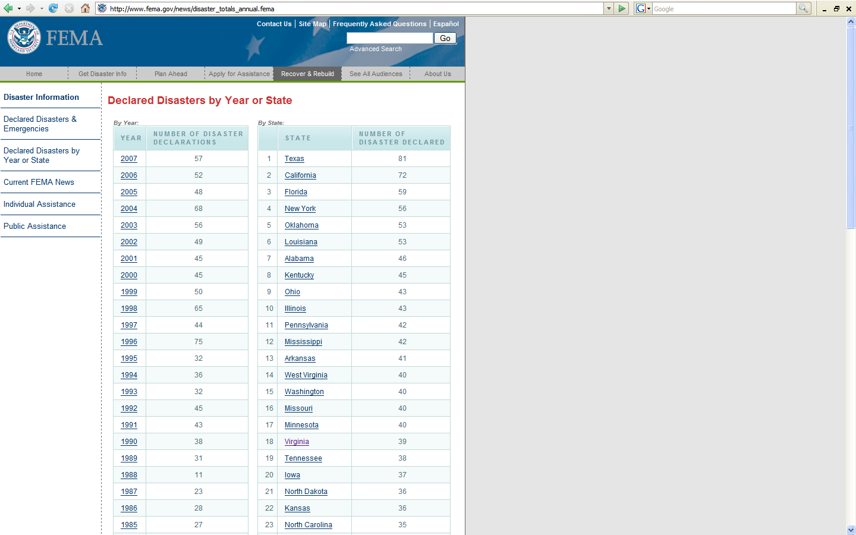
FEMA Site:
http://www.fema.gov/news/disaster_totals_annual.fema
Check this site for disaster declarations for your state.

Slide 4
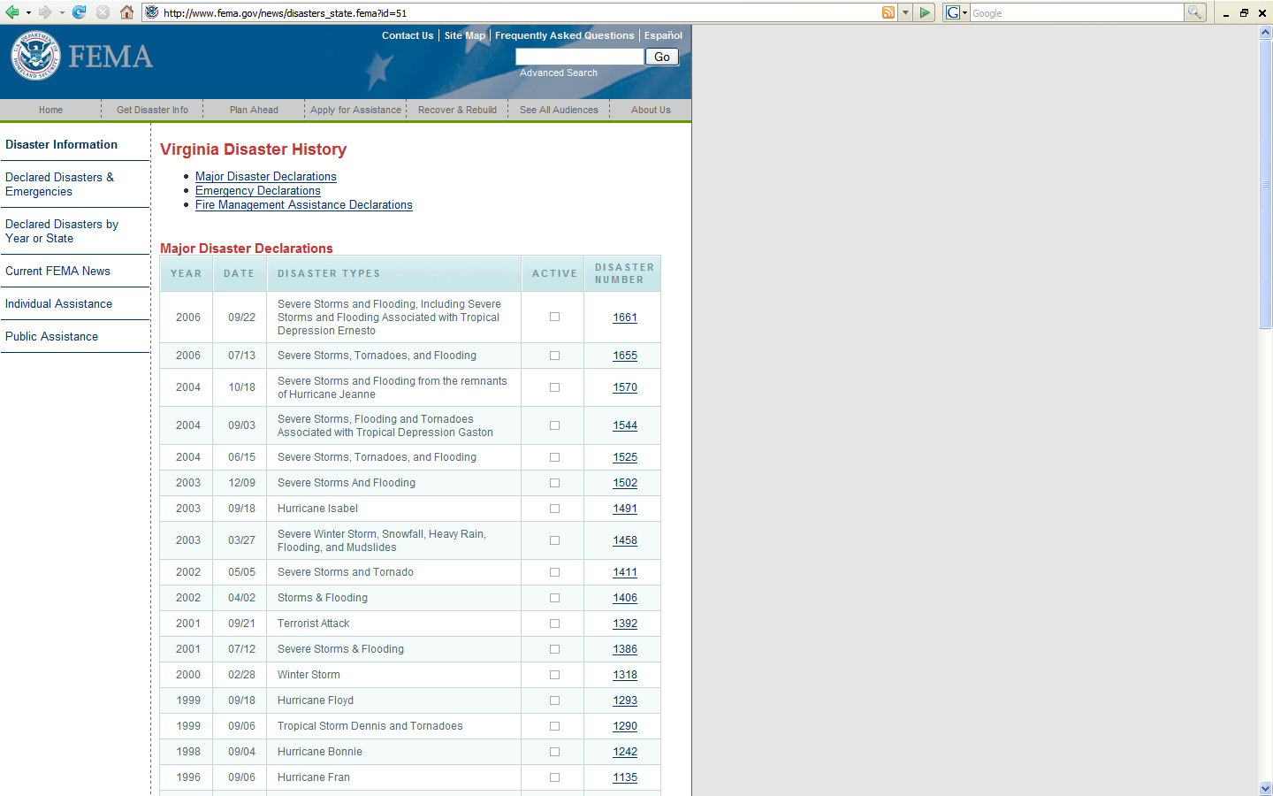
Disaster declarations for Virginia.
Most common declarations are for severe storms, flooding, and hurricanes.

Slide 5
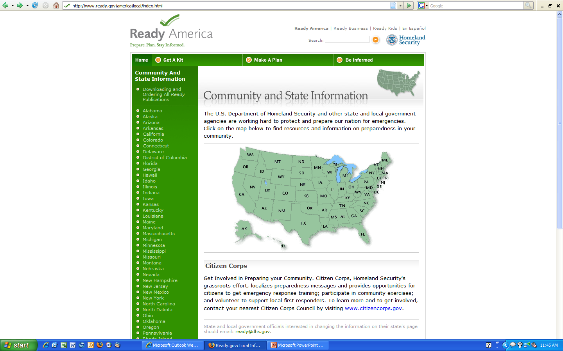
For state information on preparing for emergencies, use
http://www.ready.gov/america/local/index.html
and click on your state.

Slide 6
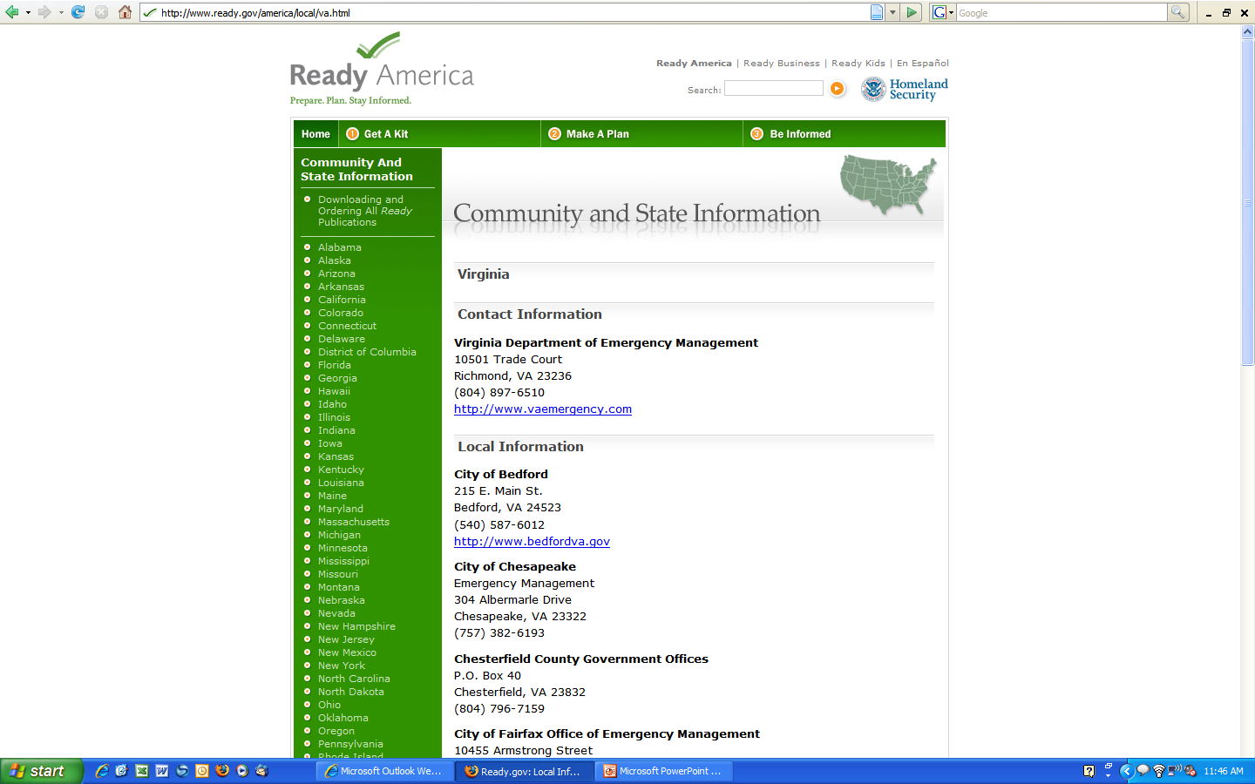
Community and state information for Virginia.

Slide 7
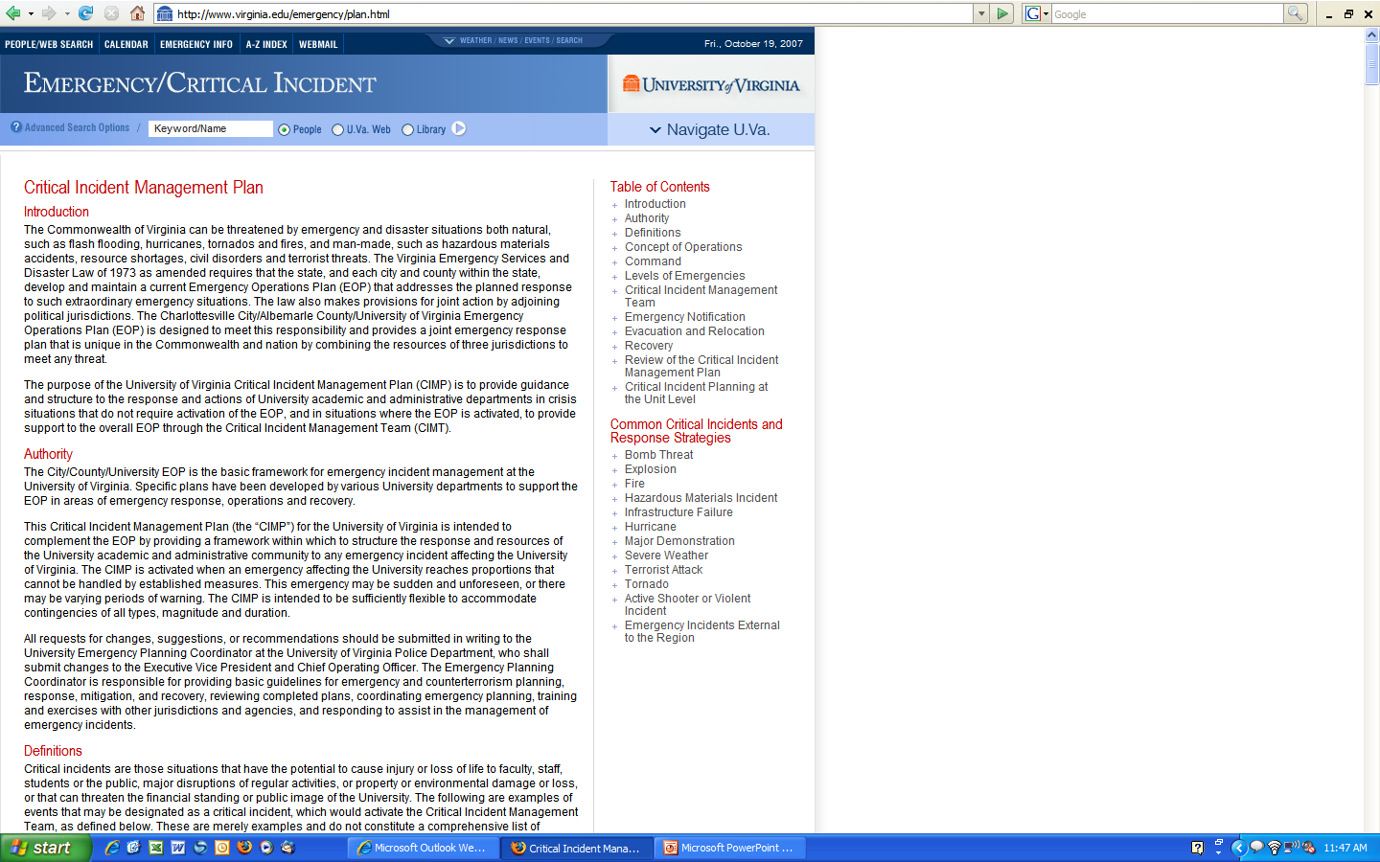
Emergency/Critical Incident plan for the University of Virginia.

Slide 8
Step Two: Determine Core Services
What services are most critical to your users? Interlibrary loan? Bibliographic searches? Reference help? Think of all the services that you offer and then prioritize them based on users’ needs.

Slide 9
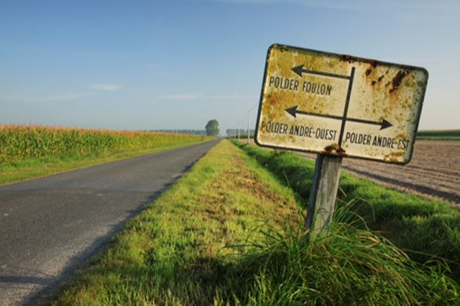
Step Three: Remote Access To Core Services
Take your list of core services and develop strategies for maintaining access to these services from an off-site location. This off-site location may be either from someone’s home (for example your ILL manager) or from a temporary location away from your building.

Slide 10



Step Four: Determine Your Core/Unique Resources
Will your users still have access to essential resources such as UpToDate, MDConsult, and StatRef if your library is closed due to a disaster that damages the building? Are there print resources, such as core textbooks, that your users might need in the aftermath of a disaster? Do you have any unique resources, such as institutional records or historical materials that would need to be recovered?

Slide 11
Step Five: Develop a Continuity of Access Plan for Your Essential Resources
Devise plans for maintaining access to essential online and print resources; would your server continue to function on back-up power, and continue to host your home page in the event of a power outage? How long would back-up power be available at your hospital?
Find or create a floorplan for your print collections and then color-code the locations of your essential print and/or historical materials based on level of importance (see example on next slide). Determine which of these collections you would spend money (might be lots of money!) to recover. Contact a commercial salvage company (such as Munters, Belfor,or BMS) to get an idea about how much it would cost to recover your materials, should freeze-drying, mold abatement, or other services be required.

Slide 12
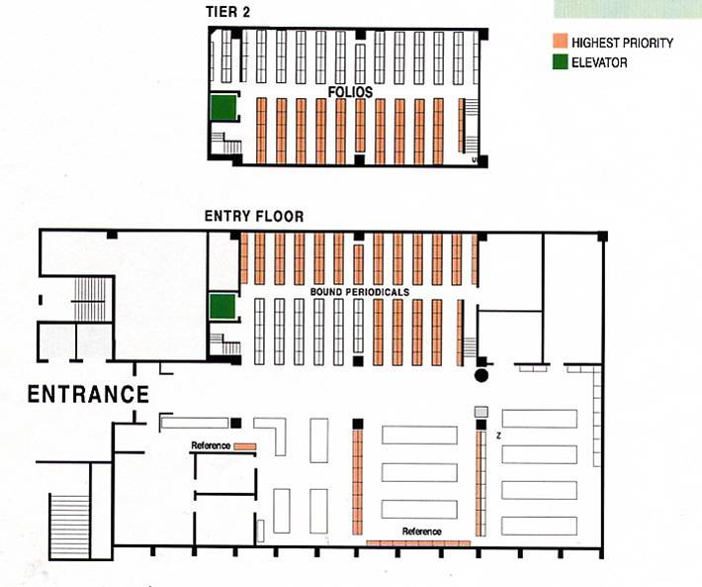
Sample salvage chart from the University of California, Berkeley

Slide 13
Step Six: Memorize
1-800-DEV-ROKS
1-800-DEV-ROKS (ROKS without a “C”) will connect you to your Regional Medical Library. Calling this number will initiate a coordinated response effort that will help you continue your services.

Slide 14

Step Seven: Drill
Create drills to test your plan. Focus specifically on how your users will be able to access important services and resources in the event of a disaster.

Slide 15
Step Eight: Review and Update
Review and update steps one through six on a quarterly basis. The easiest way to do this is to update your plan within a couple of weeks of a change in season.

Slide 16
Contact Information
Dan Wilson, Coordinator, National Network of Libraries of Medicine (NN/LM) Emergency Preparedness & Response Plan
  dtw2t@virginia.edu

